Slide 1
The Seven Churches of Revelation:
“Smyrna – Do not be Afraid but continue….even to the Point of Death”
Jesus writes to the Church in Smyrna, one Seven Churches in the Province of Asia (now Western Turkey). Rev 2:8-11
By Phil Grove, Thurrock Christian Fellowship
19th May 2024
Notes:
Jesus amongst the churches and he has them in his hand. In the Heavenlies. 2nd Church Andy’s Ephesus “Find your First Love”
Message to the Spiritual Messager/Influencer Stars in His Hand. Guardian Angel being over the Church. City wide., Angels Spectators of the church fellowship Paul 1 Cor 11v10; 1 Tim 5:21

Slide 2
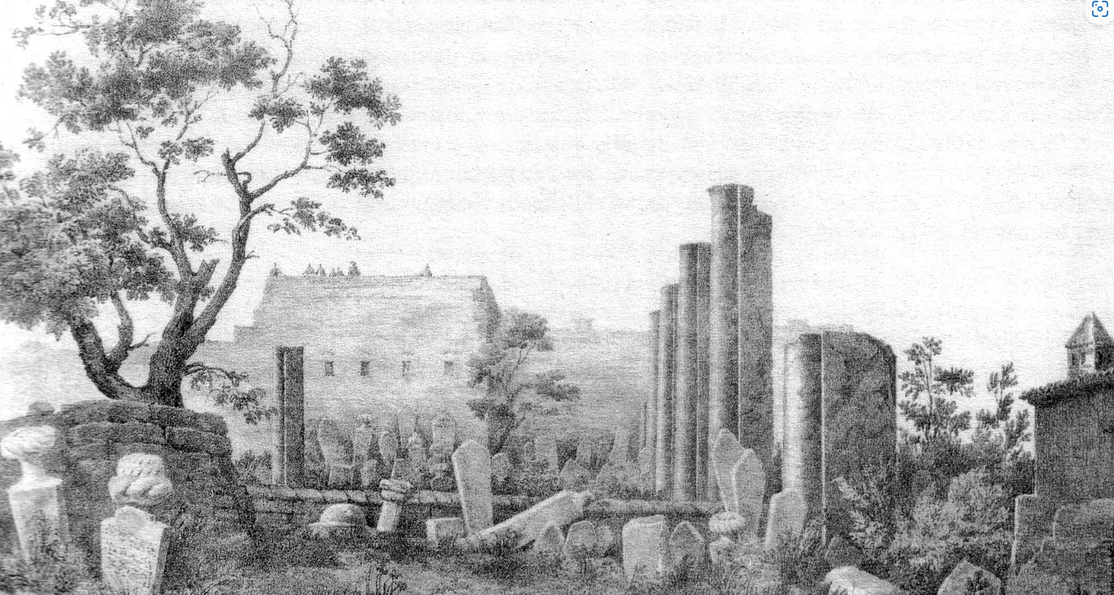
Points to Cover…
Setting the scene: John, Patmos, Lordy Day
Smyrna: its geography, background, and culture
What does Jesus know about them?
What does Jesus commend and criticise?
What promises and warnings does He give them?
How does all this apply to us in TCF today?
How does all this apply to me and you?

Slide 3
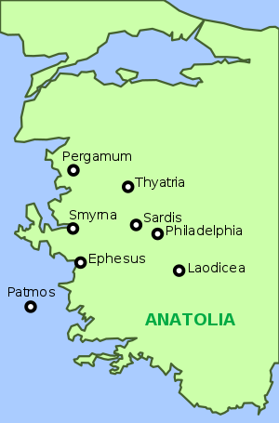
Geography of the Seven Churches…
Ephesus (now a monument)
Smyrna (now Izmir)
Pergamum (no longer exists)
Thyatira (now Akhisar)
Sardis (no longer exists)
Philadelphia (now Alasehir)
Laodicea (now Denizli)
See also Island of Patmos
Notes:
Geographically, this was known as the ‘Province of Asia’ in Roman times.

Slide 4
The Seven Churches…
Church | Name Derivation | Jesus Allusion | Commendation | Curse | Conqueror Blessing
 |  | Rev Ch 1 | Criticism
Ephesus | Desirable; Permitted | Holds 7 Stars & Among | Yes/Yes | Remove | Eat from Tree of Life
 |  | 7 Lampstands |  | Lampstand | in Paradise
Smyrna | Myrrh-ointment | First & Last, | Yes/No | None | Crown of Life
 |  | Died & came Alive
Pergamum | Married/Height | Words of a sharp | Yes/Yes | Fight against You | Hidden Manna,
 | Fortification | double edged sword |  |  | white stone in name/title
Thyratira | Sacrifice, | Eyes blazing Fire, | Yes/Yes | Repay your deeds | Rule over the nations
 | Fragance of Affliction | Feet Burished Bronze |  |  | Given Morning Star
Sardis | Prince of Joy, carnelian, | 7 Sprits of God | Yes/Yes | Come like a Thief | White garments, forever
 | Remaining/escaping | and 7 Stars |  |  | in the book of Life
Philadelphia | Brotherly Love | Holy and true, holds | Yes/Yes | None | No Tribulation, Name of God,
 |  | key Death and Hades |  |  | new Name city , new Title
Laodicea | Justice of the People | Faithful Witness (v5) | Yes/No | Spit you out | Jesus come in and eat with
 |  |  |  |  | them and sit on throne

Slide 5
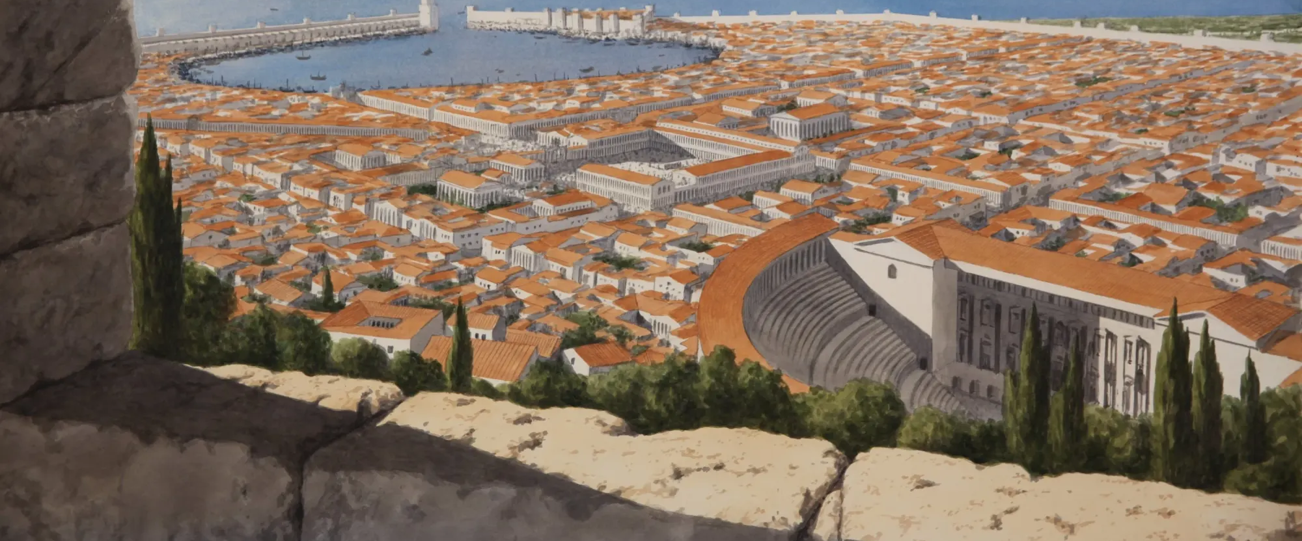
The Ancient City of Smyrna- Artists impression
Notes:
Beautiful Port City. River Fragant Groves Apollonius “the crown of Smyrna” was a familiar phrase with the Smyrnaeans; and there can be no doubt that the phrase arose form the appearance of the hill Pagos, with the stately public buildings on its rounded top and the city spreading out down its rounded sloping sides. However bad Frodo stated Strider” Look fairer smell fouler”, Lord of the Rings. Head Temples at top the hill.
Smyrna - myrrh, a bitter gum and costly perfume which exudes from a certain tree or shrub in Arabia and Ethiopia, or is obtained by incisions made in the bark: as an antiseptic it was used for embalming

Slide 6
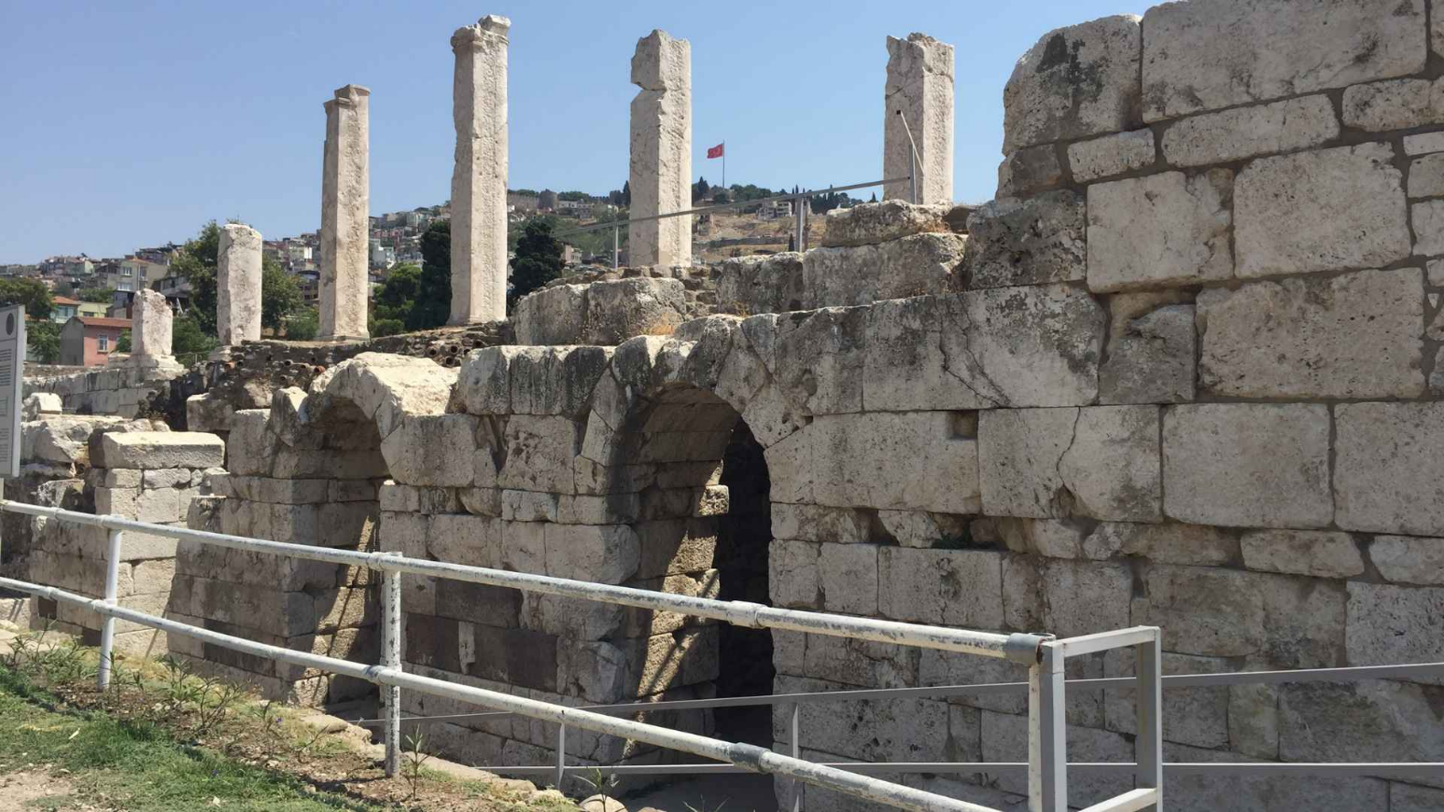
Revelation 2
⁸ And to the Church at Smyrna write: These are the words of him who is the first and the last, who died and came to life.

Slide 7
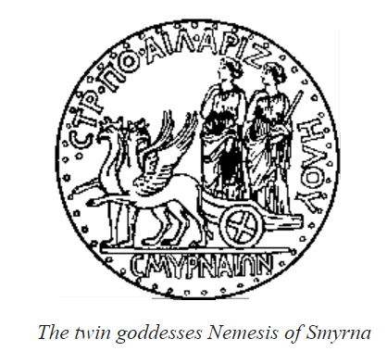
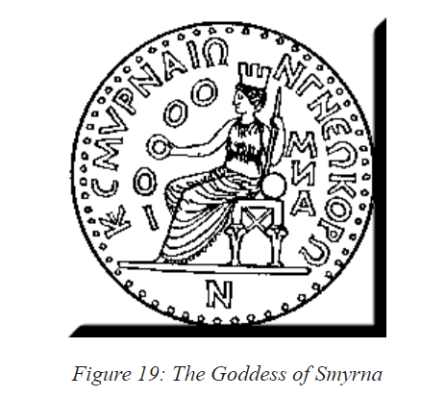
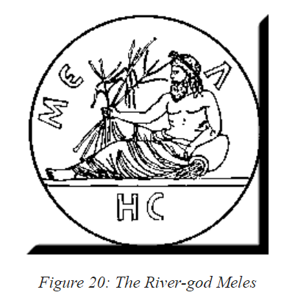
“‘I know your tribulation and your poverty (but you are rich) and the slander of those who say that they are Jews and are not but are a synagogue of Satan. Do not fear what you are about to suffer. Behold, the devil is about to throw some of you into prison, that you may be tested, and for ten days you will have tribulation. Be faithful unto death, and I will give you the crown of life.
Notes:
WM Ramsey 7 Churches
Nemesis Fate
Meles
That Nemesis was worshipped at Smyrna, where she was held equal to the mother goddess, is attributed to the hubris which caused the city's ruin in the war waged against the Lydians in the 6th century B.C.E.. Twin two peaks/hill. Two Cites. The Mother of Nemesis, Nyx.[3] Nemesis was the product of the personification of the concept of Divine Punishment/Revenge[4] ; she was a deity who took precautions against excess, who punished the immoderation of humans, and also man’s excessive confidence in himself and his good fortune.[5]

Slide 8
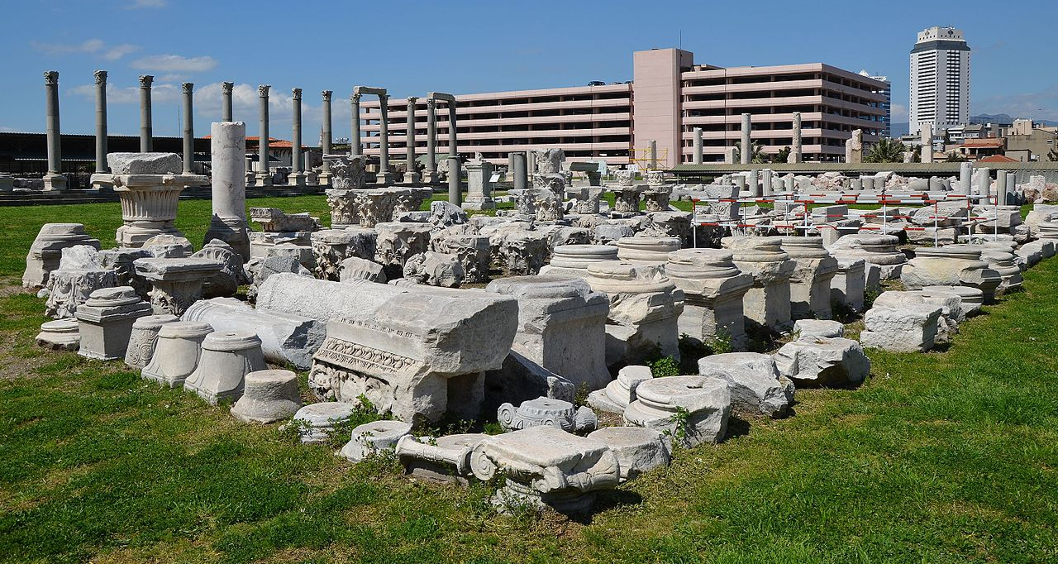
He who has an ear, let him hear what the Spirit says to the churches.
The one who conquers will not be hurt by the second death.’
Notes:
Smyrna with the Modern City of Izmir in Background.

Slide 9
Some Facts of the City of Smyrna
Smyrna Greek for Myrrh. Expensive & Lucrative Trade
During the Roman period, Smyrna was a city of great beauty and impressive architecture that circled Mount Pagus like a “crown”.
A prevailing, refreshing Zephyr blew eastwards, but also hindered drainage from the streets which were then close to sea level, causing a malodour hence myrrh

Slide 10
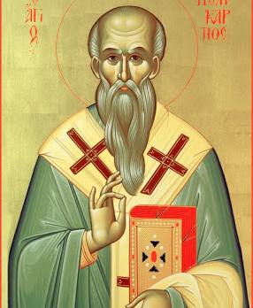
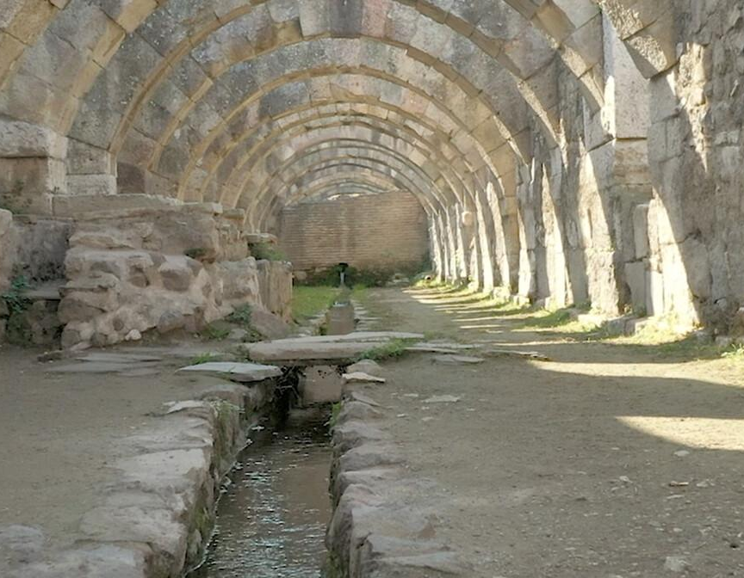
The Ancient City of Smyrna
Polycarp
Smyrna Market
Notes:
Polycarp Bishop Smyrna burned by fire and then stabbed to death on Saturday, Feb. 23, 155

Slide 11
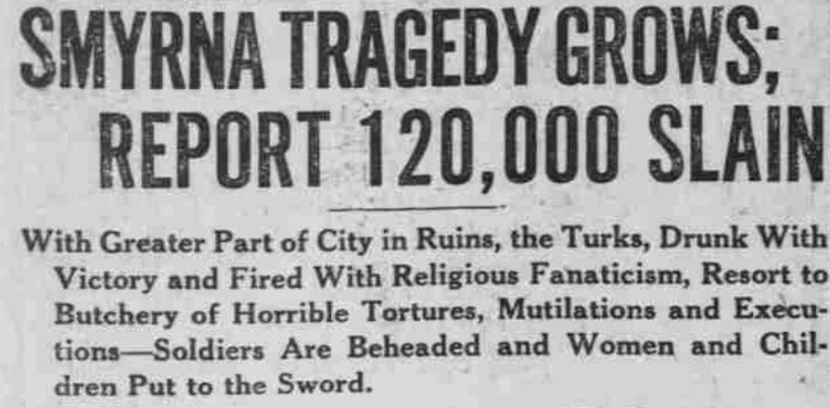
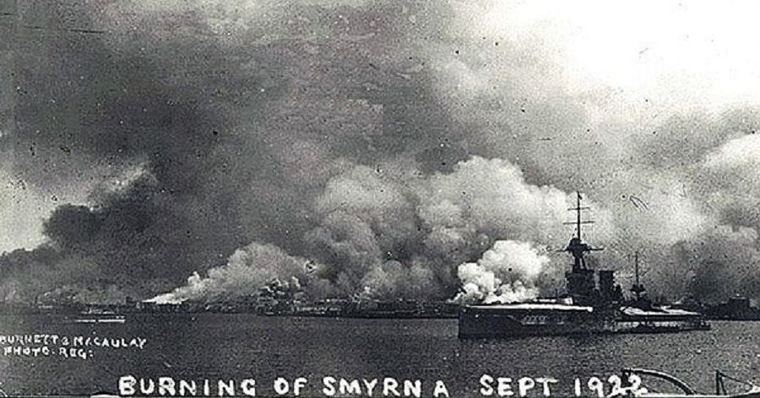

Slide 12
What does Jesus know about them?
I know your tribulation
your poverty (but you are rich)
the slander of those who say that they are Jews and are not but are a synagogue of Satan.
Behold, the devil is about to throw some of you into prison, that you may be tested, and for ten days you will have tribulation.

Slide 13
What does Jesus Commend and Criticise?
You are rich
Be faithful unto death, and I will give you the crown of life.
The one who conquers will not be hurt by the second death

Slide 14
How does all this apply to us in TCF today?
Don’t be Afraid of Poverty
You are Rich
Don’t be Afraid of Slander by others
The Truth will set you Free
Don’t be Afraid of Success or Persecution.
It won’t last

Slide 15
How does all this apply to us?
Don’t be Afraid of Poverty
You are Rich in Christ
Don’t be Afraid of Misunderstandings
The Truth will set you Free
Don’t be Afraid of Loss.
It won’t last

Slide 16
The Reward/Blessing when we feel Persecuted
Hold on. We are being tested, to show our Faith is strong and of Pure Gold.
We are more than Conquerors.
The Lord is the Alpha and Omega the Living one who will make it all worthwhile in the End.
The Victory is Certain but yet to Come

